Slide 1
Explainable Classification of Payment Difficulty
Inteligencia Artificial Explicable: estudio de caso

Slide 2
Summary of results
Five-fold CV AUC of each model
0.752
0.761
0.776
Decision tree
Logistic reg.
EBM
17 leaves, 6 rules
Accuracy 0.812
F1 0.49 at t_bal
Log of money vars.
Accuracy 0.814
F1 0.50 at t_bal
Best in 5/5 folds
Accuracy 0.817
F1 0.52 at t_bal
Same 80/20 train/validation split and the same five CV folds for every choice: hyperparameters, a log transform and the thresholds (t_acc for accuracy, t_bal for balanced accuracy). All models beat the majority baseline (accuracy 0.788); a black-box gradient-boosting model gets AUC 0.768. Submitted: the EBM.
T. S. A. Camargo · J. Corrales Almendariz · J. Montes de Oca Martínez

Slide 3
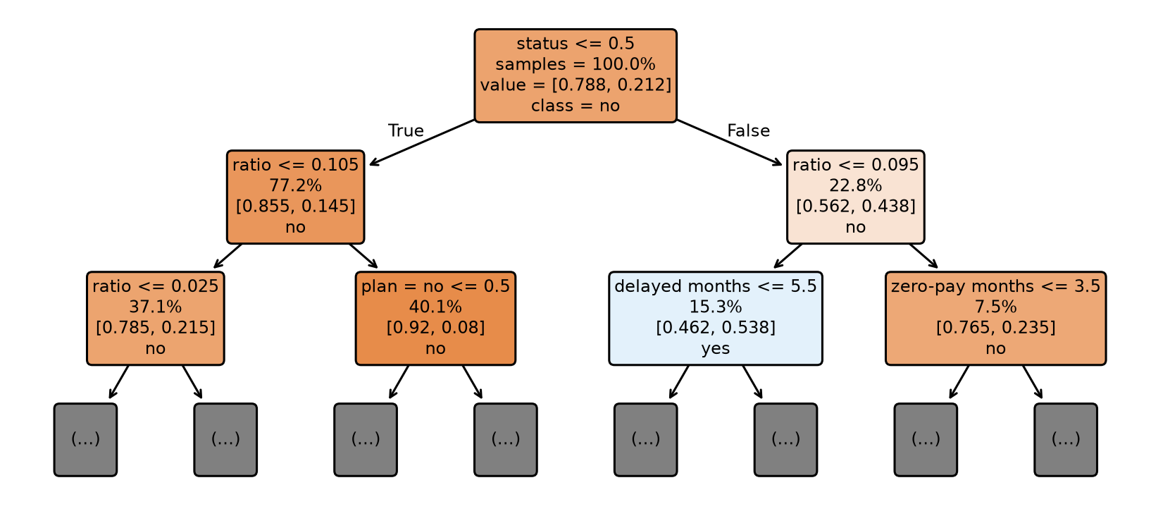
Decision tree
17 leaves that collapse into six rules
Flag difficulty if any rule fires (status = latest repayment status, ratio = payment-to-bill ratio):
R1 status ≥ 1 and ratio ≤ 0.095: risk 0.54; 15 % of clients, 39 % of all difficulties
R2 status ≤ 0 and ratio ≤ 0.025: 0.43
R3 status ≥ 1, ratio > 0.095, zero-payment months ≥ 4: 0.33
R4–R6 low ratio with age ≤ 24 or with an assistance plan: 0.26–0.32
Global: uses 7 of 15 variables; status and ratio give 85 % of its importance.
Trade-off: easiest to apply by hand, but coarse (17 probability levels): CV AUC 0.752, the lowest.
Local case C (actual: difficulty)
Path: status ≥ 1 → ratio > 0.095 → zero-payment months ≤ 3 → ratio > 0.315: leaf risk 0.15, missed.
A ratio of 4.39 on a negative bill looks safe to the tree; LR (0.50) and the EBM (0.55) flag the client.
T. S. A. Camargo · J. Corrales Almendariz · J. Montes de Oca Martínez

Slide 4
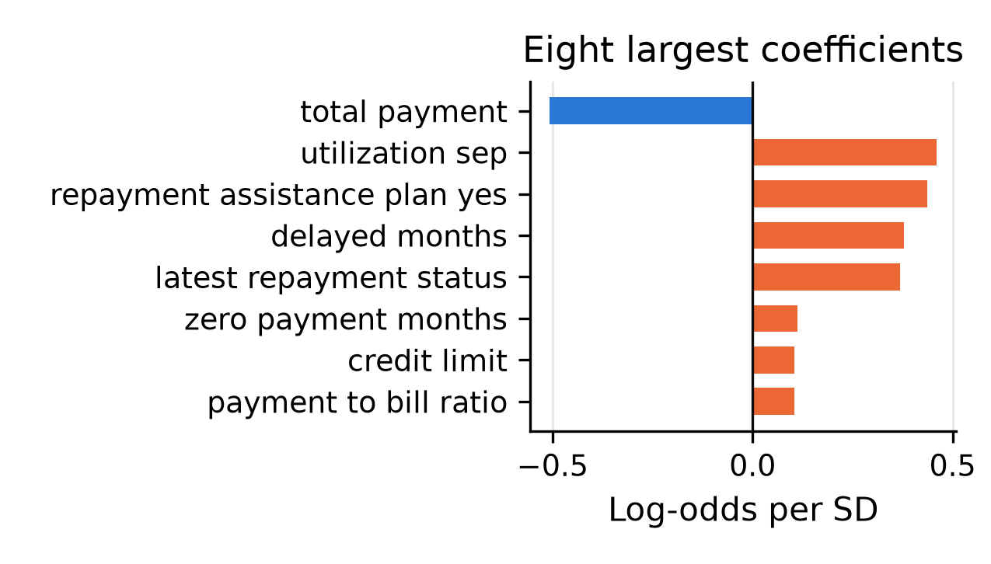

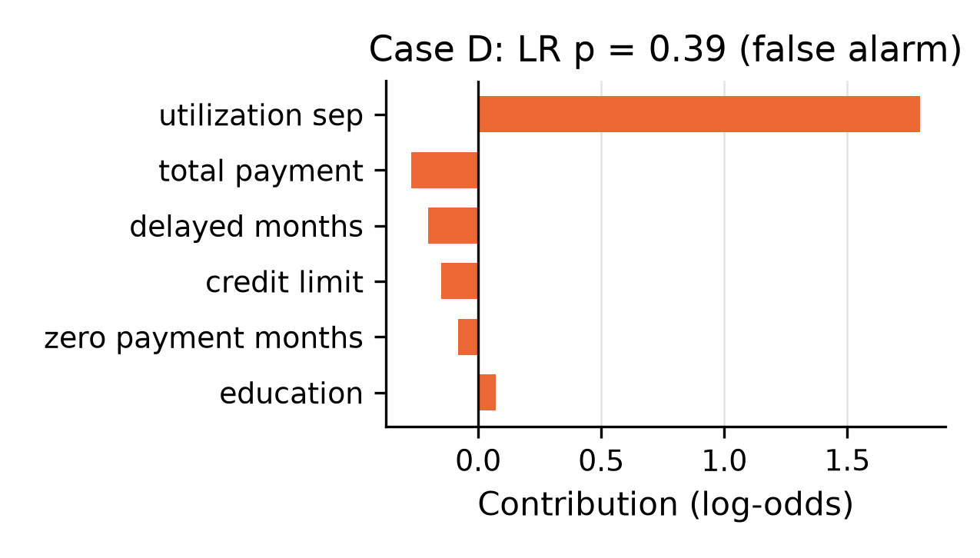
Logistic regression
Compact and stable, but conditional and linear
Setup: standardized inputs; a CV-chosen log of the money variables adds 0.012 AUC.
Global: risk rises with utilization, the assistance plan, delayed months and repayment status; it falls with total payment.
Caution: coefficients are conditional: maximum delay, credit limit and payment ratio flip their sign (collinearity).
Limit: straight lines only; status codes −2, −1 and 0 are forced onto a line.
Local, case D: utilization 2.0 adds +1.80: p = 0.39, a false alarm. The tree ignores utilization and is right.
Performance: CV AUC 0.761; F1 0.50 at t_bal.
T. S. A. Camargo · J. Corrales Almendariz · J. Montes de Oca Martínez

Slide 5
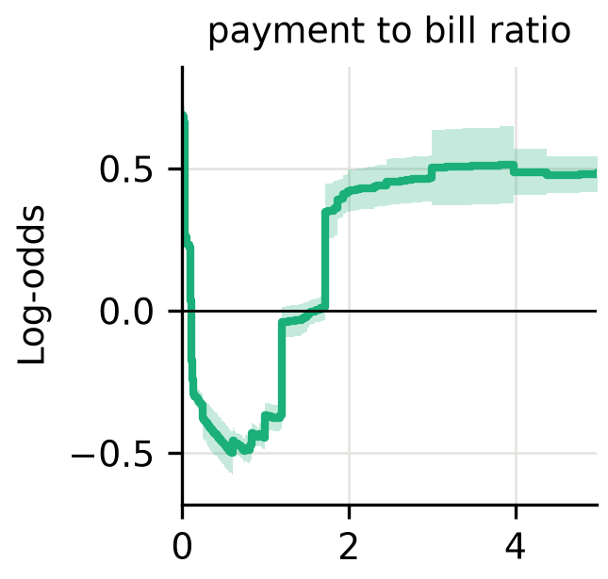
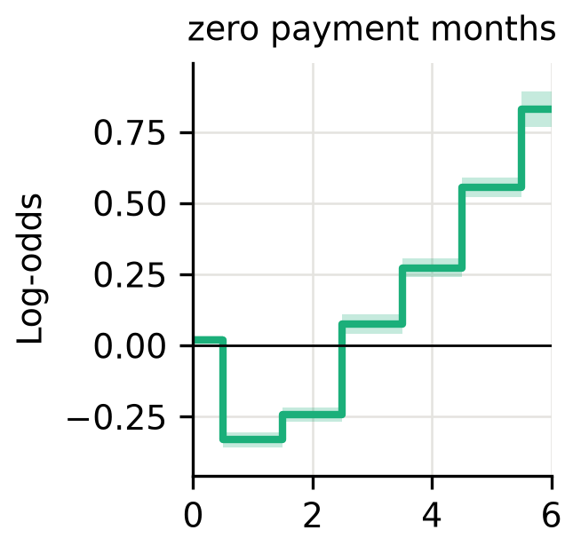
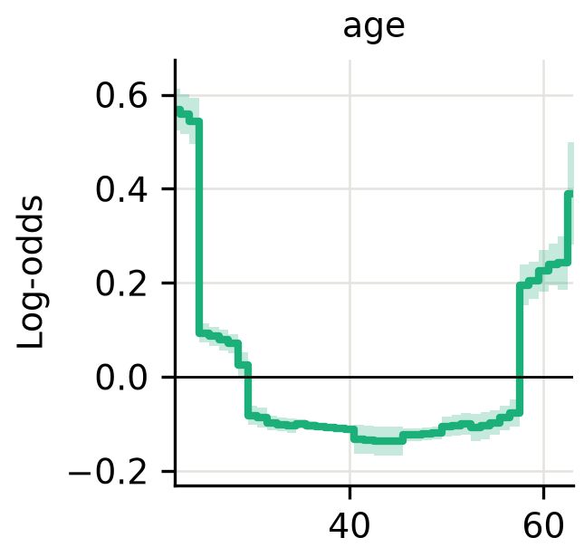




EBM
The best model: CV AUC 0.776
Ahead of LR and the tree in all five CV folds; submitted for test.csv (t_acc = 0.49).
Additive: one shape function per variable (interactions = 0), read directly from the plots.
Payment ratio is U-shaped: risk is lowest at 0.5–1.2 and rises again above 1.7 (catch-up payments, tiny bills).
Zero-payment months: 1–2 lower the risk, 3+ raise it. Forcing a monotone shape lowers the CV AUC (0.7756 → 0.7728), so the dip is real.
Age is U-shaped: clients under 25 and over 57 are riskier.
Assistance plan +0.41: a marker of earlier stress, not a causal harm.
Local case C
Ratio 4.39: +0.48
Delays: +0.49
Plan: +0.41
p = 0.55: flagged
(tree: 0.15, missed)
T. S. A. Camargo · J. Corrales Almendariz · J. Montes de Oca Martínez

